Slide 1

Live Communications Platform: Architecting and Building and Communications Enhanced Solutions
Kyle Marsh
Software Design Engineer
Live Communications

Slide 2





Live Communications Server 2003
Complete enterprise presence and IM solution:
Encryption, authentication, logging/archiving
Enterprise presence
and IM Solution
Live Communications
Server 2003
Real-Time
Communications
Platform
Flexibility of an extensible platform:
Standard protocols (SIP/SIMPLE), APIs, presence integration

Slide 3
Enterprise IM Done Right
Enterprise Solution
  Encrypted messaging
  Logging and Archiving of IM
  Integration with enterprise directory
  Simple set-up and management
  Controlled integration with public cloud (MSN Connect)
Rich and Integrated Experience
  Easy to use and familiar client
  Integration with productivity and LOB applications
  Server-side contact lists
  Multi-party IM
Extensible Platform
  Extending to voice, video, data collaboration
  Client and server platform for 3rd party applications

Slide 4





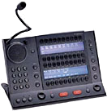



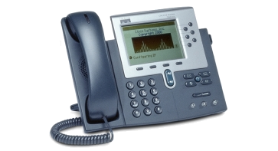


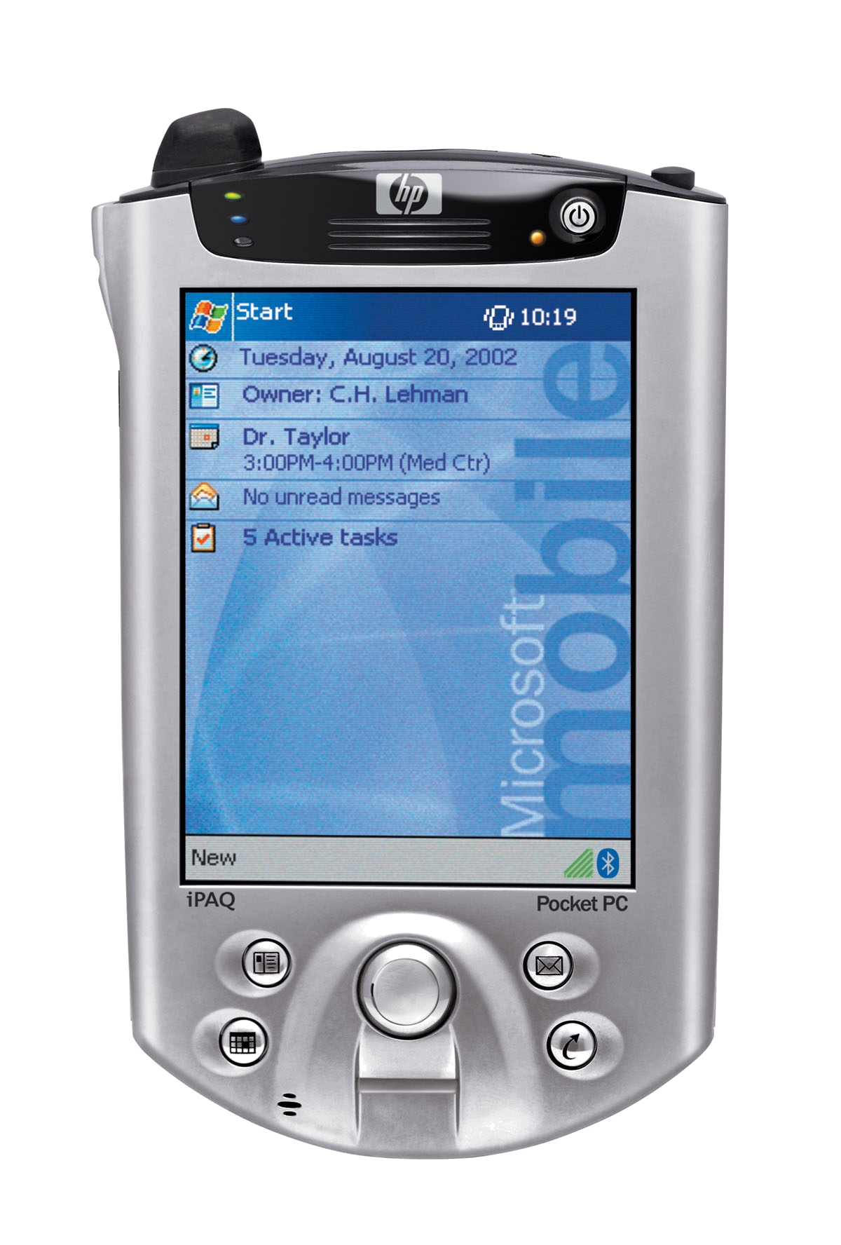




Where’s the real value ?
SCM
ERP
LOB
CRM
Integration with knowledge worker applications
Integration with productivity applications
Integration with communications infrastructure
Rich communications experience

Slide 5
What Does This Mean For Developers
Every Application should:
  Expose Presence
  Enable Instant Communication
  Drive Contextual Collaboration
Not Just Instant Messaging
  Add Value with Voice, Video, Application Sharing
  Use IM “channel” to drive business processes
  Bots, Gateways, Routers, Filters, …..

Slide 6





Live Communications Platform
Third-party Automation
Third-party Application
Windows
Messenger 5.0
Third-party Client
Third-party Script
Third-party Application
Client API
Client API
SIP

Slide 7
Customizing Windows Messenger
Branding
  Add Service Provider information to Messenger UI
Tabs
  Extend the main Messenger window with Service Provider specific information

Slide 8
Windows Messenger Demo
Branding
Tabs

Slide 9
About Messenger Automation
Messenger works on behalf of the application
COM Object
  CoCreateInstance
  CreateObject
Replace undocumented interfaces from previous releases
Aggregate Service Providers

Slide 10
What about scripting?
VBScript, JavaScript and Jscript are supported
Security Issues lead to restrictions
Exclude accessing certain user properties
  Blocked, FriendlyName, PhoneNumber, Email, SignInName
  Can get status if you know the contact information
Can’t add contact automatically
Window Positioning

Slide 11
Should I use Messenger Automation?
PROS
  Simple to develop
  Users have a familiar interface
  Inherits new features
CONS
  Separate User Experience
    Can’t control the UI
  Less control
  Unable to participate in flow of information

Slide 12
Messenger Automation

Slide 13
Client API
What is it?
  Application level COM API (C++ & VB).
  Easy to use.
A few restrictions:
  Single Threaded Apartments ONLY.
  Only one RTP session is allowed at a time.
  Application must have a message pump.

Slide 14
Architecture
User App
RTC Client API
SIP
PINT
RTP
T.120
TCP/IP

Slide 15
What about Managed Code?
COM Interop
  C#, Managed C++, VB.NET
RTCPresence sample
Build the interop assembly “by hand”
  See readme in RTCPresence sample folder

Slide 16
Example Solutions – Client API
Customer Relationship Management
  Help desk – remote assistance
Knowledge Management
  Team and project communication web sites
Integration with existing LOB applications
  Finance, Manufacturing, health care, HR, etc.
Games

Slide 17
Scalable Applications
Scalable Client Applications
  Bots
  Calendar Integration
  Notifications / Events
  IM Gateways
  IP/PBX Gateways
  RTC Client APIs on Windows Server 2003
  1.2 adds enhanced scalability for high demand applications

Slide 18
RTC Client APIs Demo

Slide 19
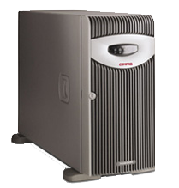
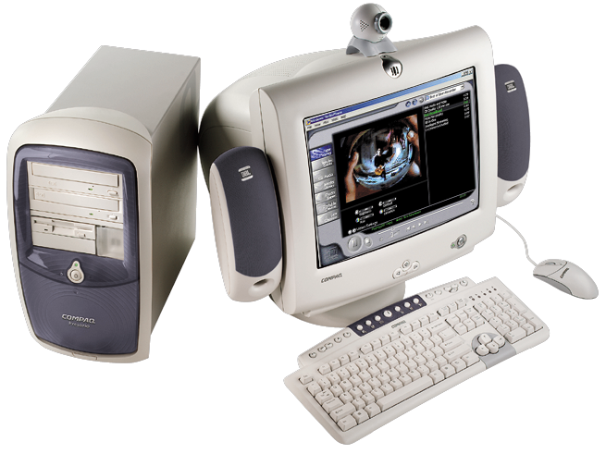
Presence, The Key Enabler
LCS
SIP Services -
Proxy
Registrar
Additional Services
Presence
Presence
IM
Video
Audio
Collaboration
Client A
Client B

Slide 20
Applications
Intelligent Agents
Authorization
Call center
Content Logging
Filtering/Virus Scanning
Billing

Slide 21
Goals
Managed API, cleanly integrated with the Windows .NET Framework.
Expose SIP. No abstraction.
Routing and proxy functionality.
Allow multiple applications to run on one server.
High performance.
Do not impose an extensive framework on applications.

Slide 22
Server APIs
Application Manifest
  No actual ISV supplied code running in Server process
  Supplied by application once running
SIP Procession Language
SIP Class Library
  Managed code
  Runs in application process
  Has complete access to requests and responses

Slide 23
Resources
MSDN
  Windows Messenger
    http://msdn.microsoft.com/library/en-us/winmessenger/winmessenger/messenger_entry.asp
  RTC Client APIs
    http://msdn.microsoft.com/library/en-us/rtcclnt/rtc/real_time_communications_rtc_client_start_page.asp
    http://msdn.microsoft.com/library/default.asp?url=/downloads/list/clientapi.asp
  Live Communications Server
    http://msdn.microsoft.com/library/en-us/rtcsrv/rtc/portal.asp

Slide 24
Discussion

Slide 25

© 2003 Microsoft Corporation. All rights reserved.
This presentation is for informational purposes only. Microsoft makes no warranties, express or implied, in this summary.

